Slide 1


Storm prediction using machine learning
SUBMITTED TO
PROF. QASIM RAFIQ
Department of Computer Science & Engineering

Slide 2



Group Members
Mansi Agrawal
Akash Sharma
Sajal Bansal
(8817103019)
(8817102001)
(8817103036)

Slide 3

Index
Introduction
The problem statement
Objective
Scope of the project
Approach
Data flow diagram
Tools and techniques
Code snippets
Conclusion
Future work

Slide 4

Introduction
Storm:- is a violent meteorological phenomena in which there is heavy rain and wind due to moisture in the air. It is predicted using weather forecasting technique.
Weather forecasting: is the application of science and technology to predict the condition of atmosphere at a specific location.
Weather conditions changes rapidly, so weather forecasting is a vital process.
This includes temperature, rain, cloudiness, wind speed and humidity.

Slide 5
Problem Statements:
Storms have the potential to harm life and property via storm surge or hevy rain.
Heavy rainfall can lead to numerous hazards for example : flooding , including risk to human life, damage to buildings and infrastructures etc.
It can also threaten human life, disrupt transport and communications, loss of crops and livestock.

Slide 6
Implementing of storm predection system using Machine Learning which can forecast weather conditions with better accuracy than the existing system.
Objectives
What we want to achieve
To enhance overall prediction capability of weather forecasting by new weather forecasting methods.

Slide 7
Scope
of the Project
Following are some areas where weather forecasting is useful:-
Air traffic
Agriculture
Forestry
Reduce loss in disasters like cyclone, flood etc.
Navy, Military
And many more.

Slide 8
Machine Learning Approach
Linear regression algorithm: shows a linear relationship between a dependent (y) and one or more independent (x) variables, hence called as linear regression. Since linear regression shows the linear relationship, which means it finds how the value of the dependent variable is changing according to the value of the independent variable.
Polynomial Regression: is a regression algorithm that models the relationship between a dependent(y) and independent variable(x) as nth degree polynomial. The Polynomial Regression equation is given below:
y= b0+b1x1+ b2x12+ b2x13+...... bnx1n

Slide 9
Machine Learning Approach
Decision Tree is a Supervised learning technique that can be used for both classification and Regression problems, but mostly it is preferred for solving Classification problems. It is a tree-structured classifier, where internal nodes represent the features of a dataset, branches represent the decision rules and each leaf node represents the outcome.
Random Forest: It is a classifier that contains a number of decision trees on various subsets of the given dataset and takes the average to improve the predictive accuracy of that dataset." Instead of relying on one decision tree, the random forest takes the prediction from each tree and based on the majority votes of predictions, and it predicts the final output.

Slide 10

IMPORTING DATA SET
CHECK ACCURACY
PREPROCESSING
OUTPUT
SPLITTING DATASET
FOR TRAIN AND TEST
APPLY ALGORITHMS
DATA FLOW DIAGRAM

Slide 11

Tools and Techniques used:
Juypter notebook (IDE)
Python 3.6

Slide 12

ALGORITHMS USED
LINEAR REGRESSION
POLYNOMIAL REGRESSION
DECISION TREE
RANDOM FOREST WITH MAX DEPTH 10
RANDOM FOREST WITH MAX DEPTH 50
notebook (IDE)
Python 3.6

Slide 13
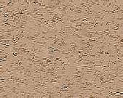
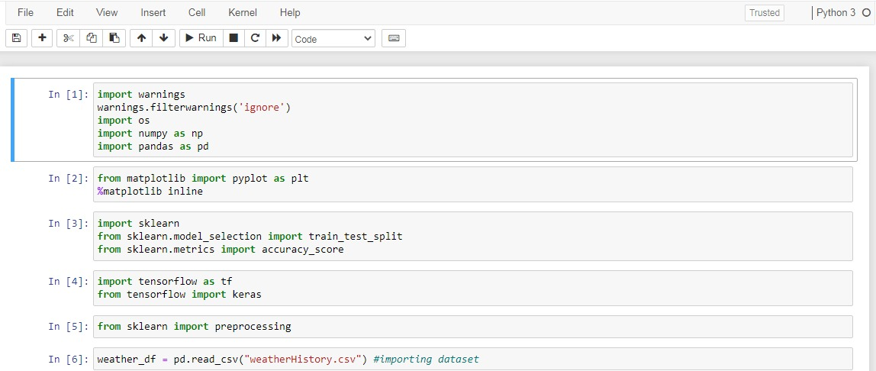
Code snippets

Slide 14

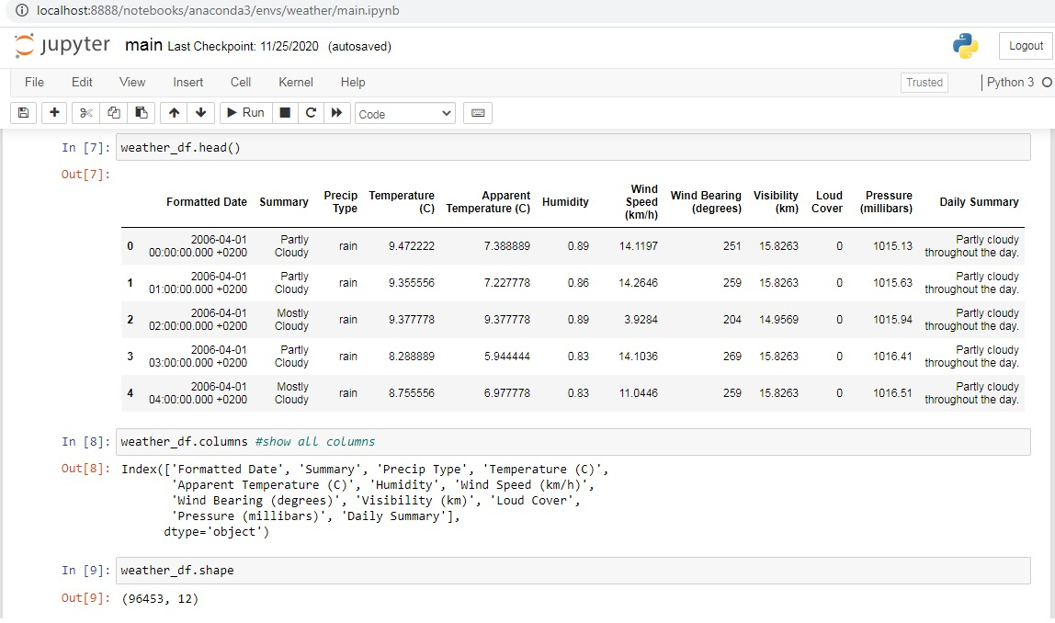
Code snippets

Slide 15
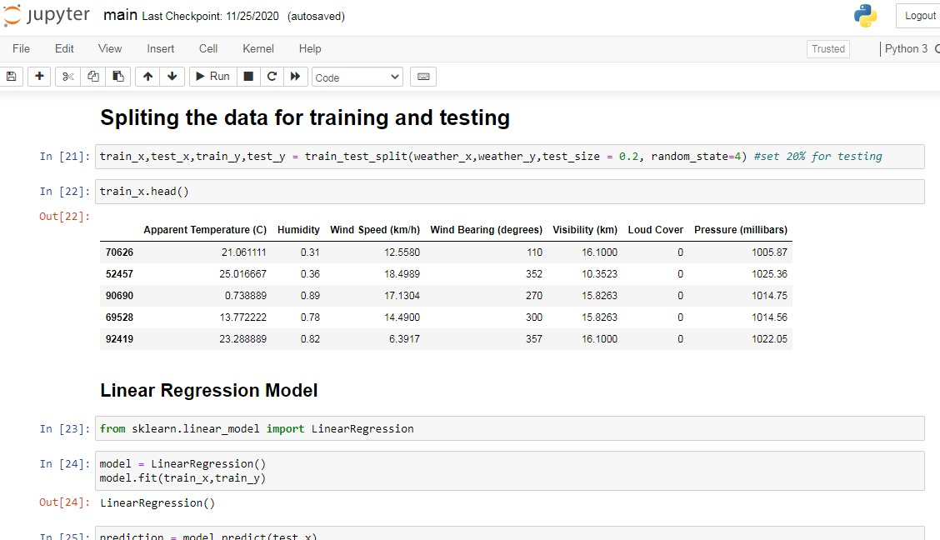
Code snippets

Slide 16

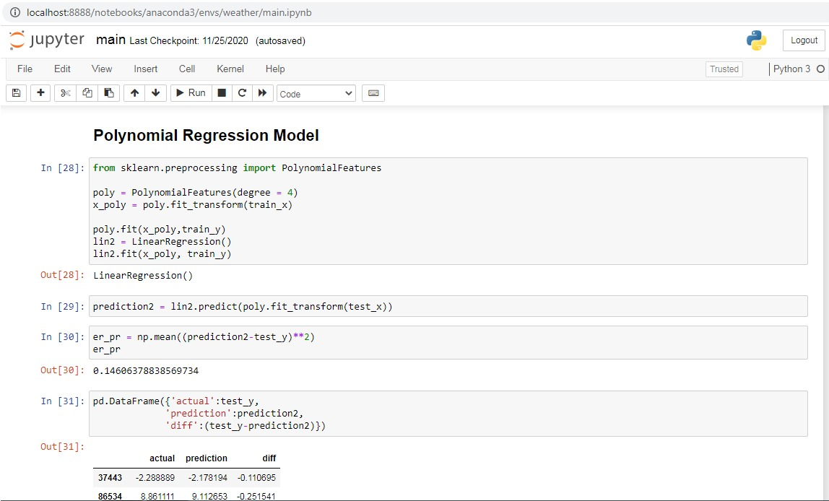
Code snippets
17

Slide 17
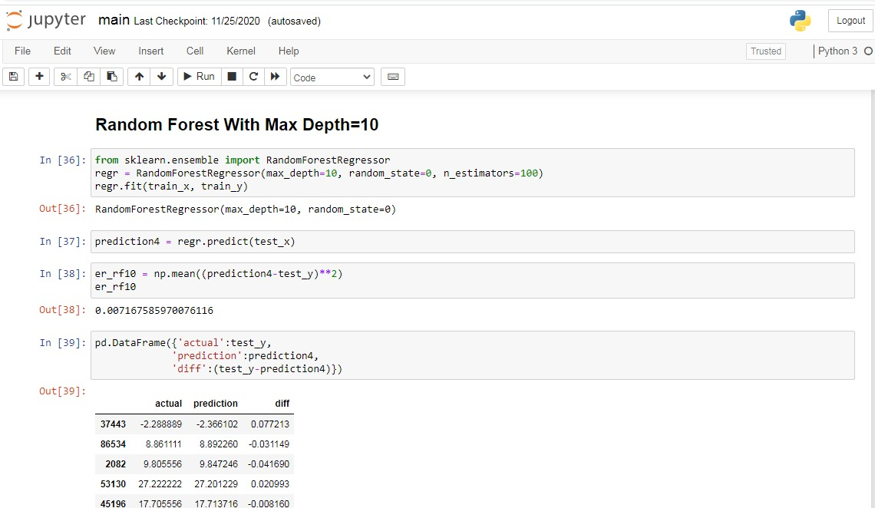
Code snippets

Slide 18
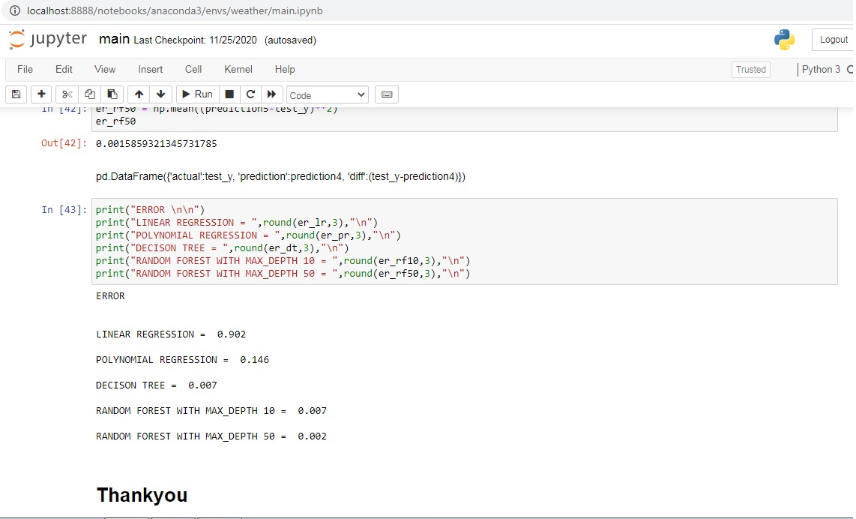
Code snippets

Slide 19
RESULT
RANDOM FOREST WITH DEPTH 50 HAS HIGHEST ACCURACY OF RAINFALL.

Slide 20

Conclusion
Weather forecasting is a useful tool for informing populations of expected weather conditions. Weather forecasting is a complex topic and poses significant variation in practice. This team will attempt to understand and implement a weather forecasting application in attempts to investigate ways upon which this area could be improved.

Slide 21

Future Work
For future improvements, following step will be performed-
Replacing model with a latest/different model.
Using other robust datasets.
Predicting result on more attributes.
Training model on higher session.

Slide 22



